Slide 1

#RahoAmbitious
TechM Full Stack Software Development

Slide 2



Lecture On: CSS Colors, Background and Box Model
Instructor: Rushabh Shah

Slide 3
In the last class, we discussed...
Introduction to HTML5
New semantic elements introduced in HTML5
Introduction to CSS
How to add CSS and style your website
CSS height, width and units

Slide 4



Poll 1 (15 Sec)
How will you target all the elements with h2 and h3 tags to have the same styling?
* { }
#h2, #h3 { }
h2, h3 { }
All of the above
Practice in teams of 4 students
Industry expert mentoring to learn better
Get personalised feedback for improvements
11

Slide 5
Poll 1 (Answer)
How will you target all the elements with h2 and h3 tags to have the same styling?
* { }
#h2, #h3 { }
h2, h3 { }
All of the above
Practice in teams of 4 students
Industry expert mentoring to learn better
Get personalised feedback for improvements
11

Slide 6
Poll 2 (15 Sec)
Which of the following is the correct HTML syntax to specify an external stylesheet?
<stylesheet>style.css</stylesheet>
<style src=“style.css></style>
<link rel=“stylesheet” href=“style.css” />
<link rel="stylesheet" src="style.css"/>
Practice in teams of 4 students
Industry expert mentoring to learn better
Get personalised feedback for improvements
11

Slide 7
Poll 2 (Answer)
Which of the following is the correct HTML syntax to specify an external stylesheet?
<stylesheet>style.css</stylesheet>
<style src=“style.css></style>
<link rel=“stylesheet” href=“style.css” />
<link rel="stylesheet" src="style.css"/>
Practice in teams of 4 students
Industry expert mentoring to learn better
Get personalised feedback for improvements
11

Slide 8
Poll 3 (15 Sec)
Which of the following is the correct syntax for inserting a comment in CSS?
// This is a comment.
<!– This is a comment -->
/* This is a comment */
“This is a comment”
Practice in teams of 4 students
Industry expert mentoring to learn better
Get personalised feedback for improvements
11

Slide 9
Poll 3 (Answer)
Which of the following is the correct syntax for inserting a comment in CSS?
// This is a comment.
<!– This is a comment -->
/* This is a comment */
“This is a comment”
Practice in teams of 4 students
Industry expert mentoring to learn better
Get personalised feedback for improvements
11

Slide 10

Today’s Agenda
How to use colors in CSS
How to add backgrounds in CSS
How to add borders, margins and paddings to CSS
What is a CSS box model?
How to add outlines to CSS

Slide 11

CSS Colors

Slide 12
CSS Colors
Where Can You Apply Colors?
ABCDEFGHIJK
background-color
text-color
border-color

Slide 13
CSS Colors
Different Ways of Typing Colors in CSS
red
div { color: red; }
rgb(255, 0, 0)
div { color: rgb(255, 0, 0); }
#ff0000
div { color: #ff0000; }
hsl(0, 100%, 50%)
div { color: hsl(0, 100%, 50%); }
rgba(255, 0, 0, 0.5)
div { color: rgba(255, 0, 0, 0.5); }
hsla(0, 100%, 50%, 0.5)
div { color: hsl(0, 100%, 50%, 0.5); }

Slide 14
CSS Colors
Different Ways of Typing Colors in CSS: Color Name
The color value is as follows:
red
The following syntax is used:
.container { color: red; }
To add a color using the color name, you simply need to add the color name to an HTML element.
The values can be colors such as orange, blue, green and yellow.
You can read more about CSS colors here.

Slide 15
CSS Colors
Different Ways of Typing Colors in CSS: RGB
The color value is as follows:
R G B
rgb(255, 0, 0)
The following syntax is used:
div { color: rgb(255, 0, 0); }
Red (0–255)
Green (0–255)
Blue (0–255)
To add a color using RGB, you simply need to add a value between 0 and 255 for the respective color.
For example, for a pure red color, it will be rgb(255, 0, 0), where 255 denotes the purest shade of red. For a lighter shade of red, you can reduce the value to less than 255, for example, rgb(100, 0, 0).
If you want a color such as yellow, then you can simply add its combination such as rgb(255,255,0).

Slide 16
CSS Colors
Different Ways of Typing Colors in CSS: HEX
The color value is as follows:
#FFFFFF
#ff0000
Red (00–FF)
The following syntax is used:
Green (00–FF)
div { color: #ff0000; }
Blue (00–FF)
To add a color using HEX, you simply need to add a value between 00 and FF for the respective color.
For example, for a pure red color, it will be #ff0000, wherein ff denotes the purest shade of red. For a lighter shade of red, you can reduce the value to less than ff, for example, #2a0000.
If you want a color such as yellow, then you can simply add its combination #ffff00.

Slide 17
CSS Colors
Different Ways of Typing Colors in CSS: HSL
The color name is as follows:
H S L
hsl(0, 100%, 50%)
The following syntax is used:
div { color: hsl(0, 100%, 50%); }
Hue
0–360
Saturation
0% –100%
Lightness
0% –100%
Hue stands for color. Its value is a degree on the color wheel. 0 is red, 120 is green and 240 is blue.
Saturation stands for the intensity of color, where 100% is pure color, 50% is half grey and half color, and 0% is pure grey.
Lightness stands for the amount of light that you want to give the color. 0% is no light (black), 50% means neither light nor dark, and 100% means full light (white).

Slide 18
CSS Colors
Different Ways of Typing Colors in CSS: RGBA
The color name is as follows:
R G B A
rgba(255, 0, 0, 0.5)
The following syntax is used:
div { color: rgba(255, 0, 0, 0.5); }
Red (0–255)
Green (0–255)
Blue (0–255)
Alpha (0–1)
In addition to RGB, you can add a touch of transparency/opacity using the alpha value.
It takes a value from 0 to 1, where 0 stands for fully transparent and 1 stands for fully opaque.

Slide 19
CSS Colors
Different Ways of Typing Colors in CSS: HSLA
The color name is as follows:
H S L A
hsla(0, 100%, 50%, 0.5)
The following syntax is used:
div { color: hsla(0, 100%, 50%, 0,5); }
Hue
0 - 360
Saturation
0% - 100%
Lightness
0% - 100%
Alpha
0 - 1
In addition to HSL, you can add transparency to the color.
It takes a value from 0 to 1, where 0 stands for fully transparent and 1 stands for fully opaque.

Slide 20
Poll 4 (15 Sec)
Which of the following is true about the RGB stream?
(Note: More than one option may be correct.)
RGB stands for red, green and blue.
It is represented within the range (0, 0, 0) and (255, 255, 255).
It is represented by #RRGGBB.
RGB stands for red, grey and black.
Practice in teams of 4 students
Industry expert mentoring to learn better
Get personalised feedback for improvements
11

Slide 21
Poll 4 (Answer)
Which of the following is true about the RGB stream?
(Note: More than one option may be correct.)
RGB stands for red, green and blue.
It is represented within the range (0, 0, 0) and (255, 255, 255).
It is represented by #RRGGBB.
RGB stands for red, grey and black.
Practice in teams of 4 students
Industry expert mentoring to learn better
Get personalised feedback for improvements
11

Slide 22
Poll 5 (15 Sec)
Which of the following is the correct way of assigning a certain color to an element in CSS?
(Note: More than one option may be correct.)
RGB
RGBA
HEX
HSLA
Practice in teams of 4 students
Industry expert mentoring to learn better
Get personalised feedback for improvements
11

Slide 23
Poll 5 (Answer)
Which of the following is the correct way of assigning a certain color to an element in CSS?
(Note: More than one option may be correct.)
RGB
RGBA
HEX
HSLA
Practice in teams of 4 students
Industry expert mentoring to learn better
Get personalised feedback for improvements
11

Slide 24
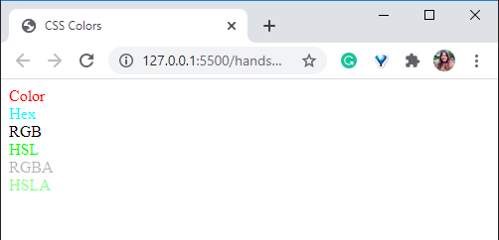
Hands-On Exercise (3 min)
Your are given a HTML stub code to which you are required to write any external CSS such that following points are satisfied:
The color of container1 should be declared with color value “red”
The color of container2 should be declared with hex code “00ffff”
The color of container3 should be declared using RGB code for black.
The color of container4 should be declared using HSL code for green such that the saturation is complete and the lightness is half.
The color of container5 should be declared using RGBA code for black having opacity of 0.3.
The color of container6 should be declared using HSLA code for green such that the saturation is complete, the lightness is half and opacity is 0.5.
The stub code is provided here.
The solution code is provided here.

Slide 25

CSS Backgrounds

Slide 26
CSS Backgrounds
Background Color and Opacity
background-color
opacity
div
div
The syntax used is as follows:
The syntax used is as follows:
div { background-color: green; }
div { background-color: green; opacity: 0.5; }
To give a background color to an element, you can simply use the background-color syntax.
Giving opacity to an element will give the same opacity to every child element inside the div.

Slide 27

CSS Backgrounds
Background Image
The syntax used is as follows:
body { background-image: url(‘images/oranges.jpg’); }

Slide 28
CSS Backgrounds
Background Repeat
If the size of an image is smaller than that of the container for adding a background, then the image will repeat itself. The background-repeat property will define if the background image should be repeated or not.
body { background-image: url(‘images/oranges.jpg’); background-repeat: repeat-x; }
body { background-image: url(‘images/oranges.jpg’); background-repeat: repeat-y; }
repeat-x
repeat-y

Slide 29
CSS Backgrounds
Background Repeat
The background-repeat property will define if the background image should be repeated or not.
The default valiue of background-repeat property is repeat.
body { background-image: url(‘images/oranges.jpg’); background-repeat: repeat; }
body { background-image: url(‘images/oranges.jpg’); background-repeat: no-repeat; }
repeat
no-repeat

Slide 30
CSS Backgrounds
Background Position
The background-position property will define where the background image will be placed.
It can be either initial, inherit, ‘right/left/centre top/centre/bottom’, ‘x% y%’ or ‘xpos ypos’.
body { background-image: url(‘images/oranges.jpg’); background-repeat: no-repeat; background-position: right top; }

Slide 31
CSS Backgrounds
Background Size
The background-size property is used to define the size of the background image. While you can set the height and width of the background image using simple height and width properties, you can also set it in the following three unique ways.
background-size: auto
background-size: cover
background-size: contain
This will resize the image to fit the container, even if it needs to stretch the image or cut off its edges.
This will resize the image, ensuring that the image is fully visible.
This will give the original size of the image. This is the default value of background-size of not defined explicitly.

Slide 32
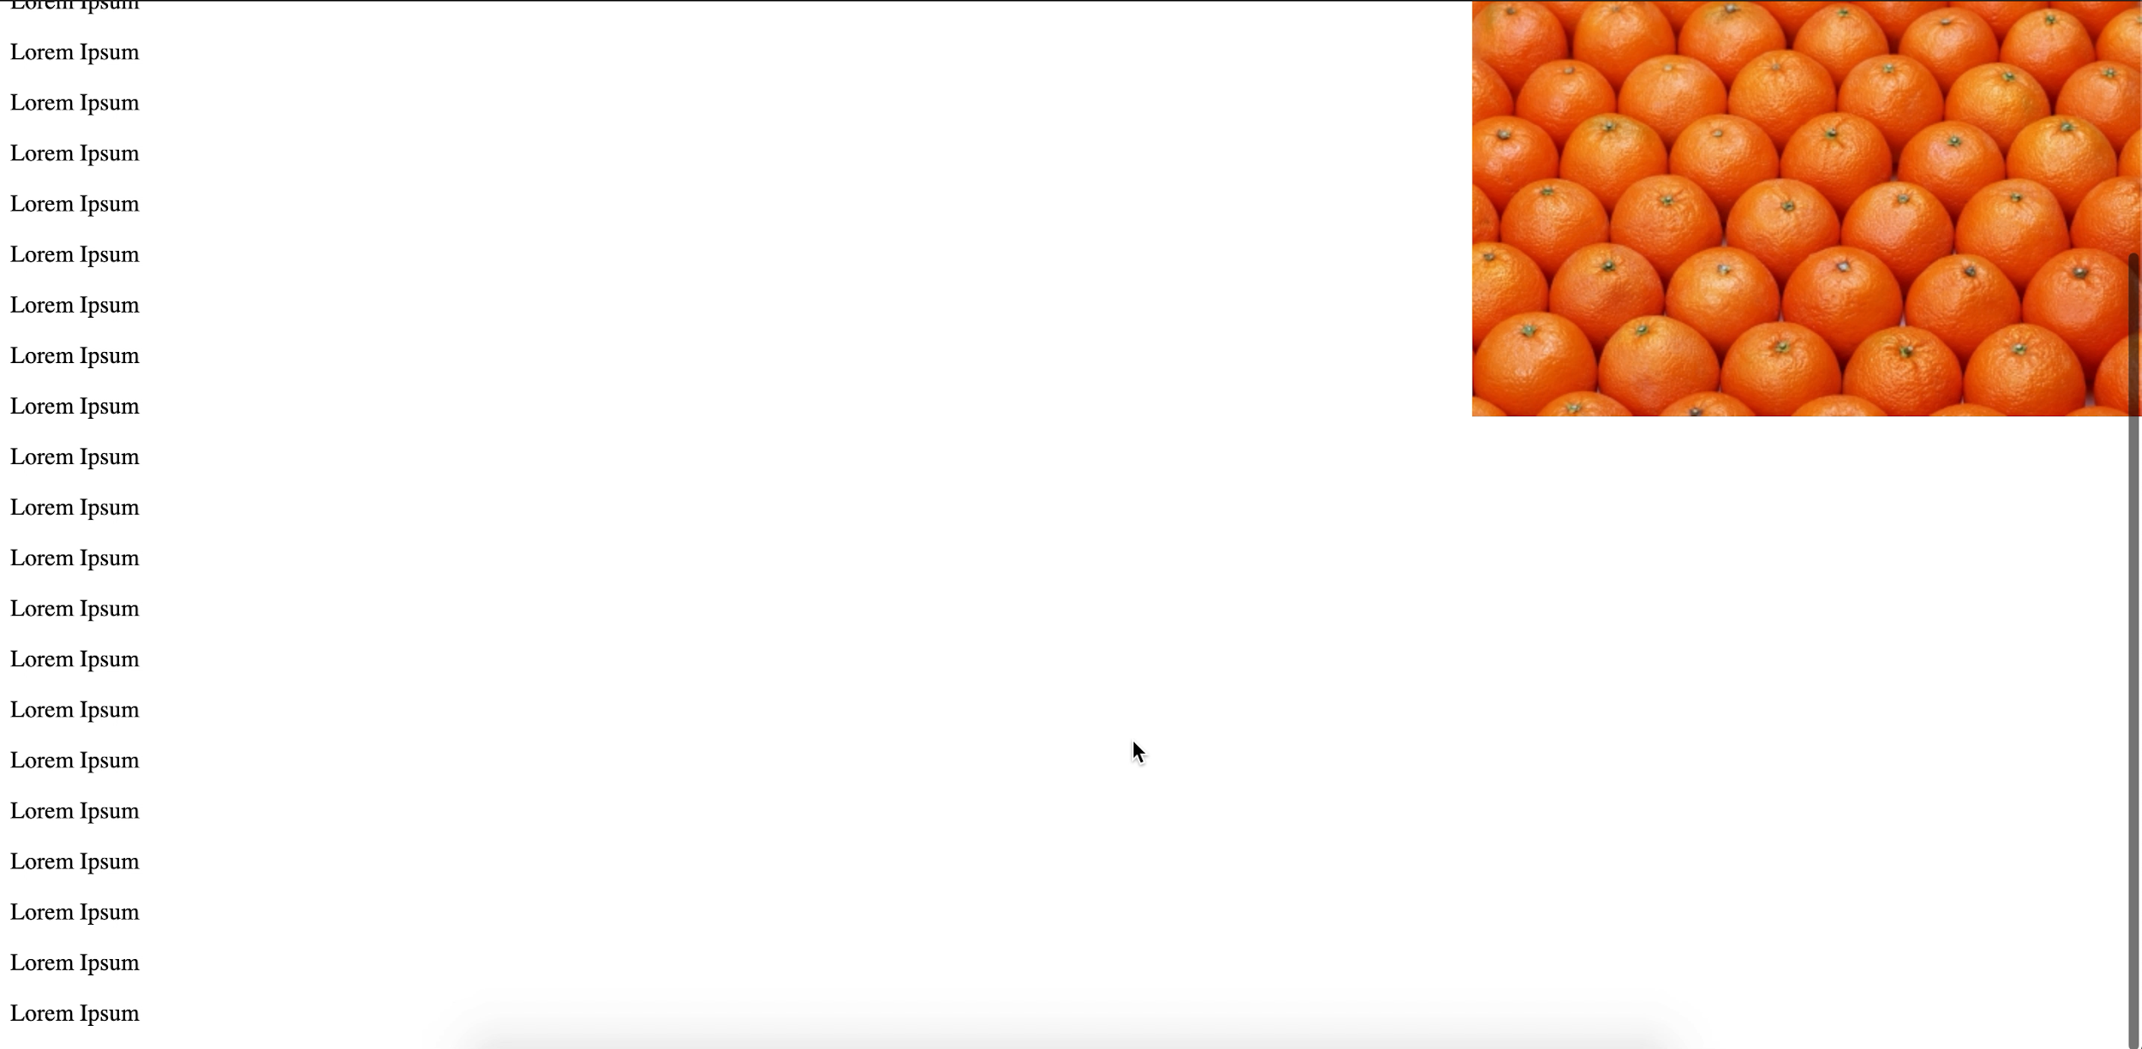
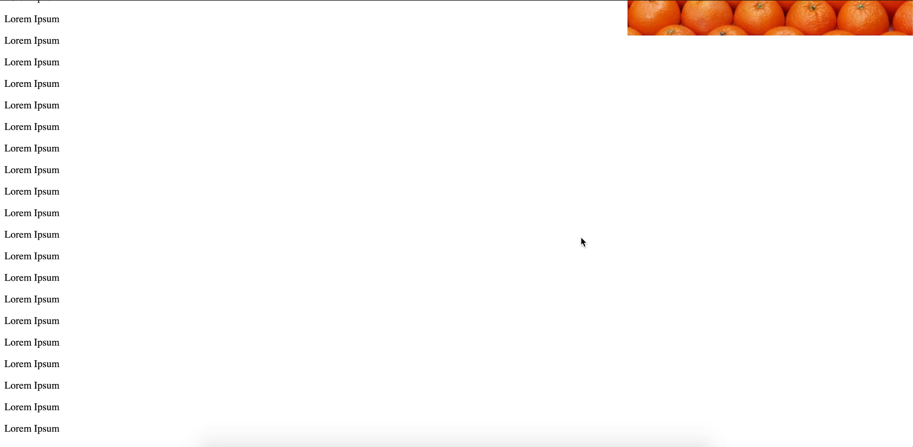
CSS Backgrounds
Background Attachment
The background-attachment property specifies whether the background will scroll with the rest of the page or remain fixed.
background-attachment: fixed
background-attachment: scroll

Slide 33
CSS Backgrounds
Background Attachment
The background-attachment property specifies whether the background will scroll with the rest of the page or remain fixed.
The default value of background-attachment property is scroll.
When we set the background-attachment as scroll, the background will scroll when the page is scrolled.
background-attachment: scroll

Slide 34
CSS Backgrounds
Background Attachment
The background-attachment property specifies whether the background will scroll with the rest of the page or remain fixed.
When we set the background-attachment as fixed, the background will not scroll when the page is scrolled instead it stays fixed at that position.
background-attachment: fixed

Slide 35
CSS Backgrounds
Background Shorthand
The background shorthand property specifies all the background properties in one line.
The syntax used is as follows: background: background-color,background-image,background-position,background-size,background-repeat, background-origin,background-clip, background-attachment.
If we omit any of the sub property value in the shorthand property, the value of that sub property is set to initial value,
Property | Initial Value
background-clip | border-box
background-color: | transparent
background-image: | none
background-origin: | padding-box
background-position: | 0% 0%
background-repeat: | repeat
background-size: | auto
background-attachment: | scroll
body { background:#ffffff url(‘images/oranges.jpg’) 0% 0% cover no-repeat border-box padding-box fixed; }

Slide 36
Poll 6 (15 Sec)
Which of the following properties is used to change the background color?
(Note: more than one can be correct)
bgcolor
color
background-color
background
Practice in teams of 4 students
Industry expert mentoring to learn better
Get personalised feedback for improvements
11

Slide 37
Poll 6 (Answer)
Which of the following properties is used to change the background color?
(Note: more than one can be correct)
bgcolor
color
background-color
background
Practice in teams of 4 students
Industry expert mentoring to learn better
Get personalised feedback for improvements
11

Slide 38
Poll 7 (15 Sec)
Which of the following is the correct syntax for adding a background image?
(Note: more than one can be correct)
image: url(“myimage.png”)
background-image: “myimage.png”
background-image: url(“myimage.png”)
background: url("myimage.png/")
Practice in teams of 4 students
Industry expert mentoring to learn better
Get personalised feedback for improvements
11

Slide 39
Poll 7 (Answer)
Which of the following is the correct syntax for adding a background image?
(Note: more than one can be correct)
image: url(“myimage.png”)
background-image: “myimage.png”
background-image: url(“myimage.png”)
background: url("myimage.png/")
Practice in teams of 4 students
Industry expert mentoring to learn better
Get personalised feedback for improvements
11

Slide 40
Poll 8 (15 Sec)
Which of the following statements is correct about background-attachment property?
It specifies how the background should be positioned.
It specifies how the background should be repeated.
It specifies whether the background should scroll with the page or remain fixed.
It specifies the size of the background image.
Practice in teams of 4 students
Industry expert mentoring to learn better
Get personalised feedback for improvements
11

Slide 41
Poll 8 (Answer)
Which of the following statements is correct about background-attachment property?
It specifies how the background should be positioned.
It specifies how the background should be repeated.
It specifies whether the background should scroll with the page or remain fixed.
It specifies the size of the background image.
Practice in teams of 4 students
Industry expert mentoring to learn better
Get personalised feedback for improvements
11

Slide 42
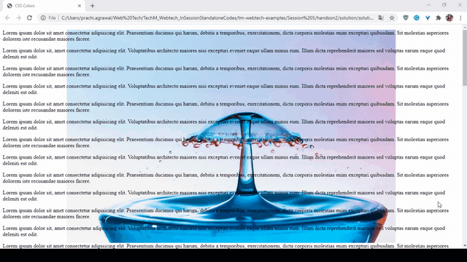
Hands-On Exercise (3 min)
The HTML code is given to you in the stub and you are required to add the following internal CSS to the class container.
Add the background image for the container: https://cdn.pixabay.com/photo/2020/06/07/05/48/drop-5269146_960_720.jpg
The position of the image should be 50% on the x-axis and 0% on the y-axis.
The image should not repeat.
As we scroll across the web page, the image should remain static at the given position and only the remaining elements on the web page should scroll.
You are required to define all this properties on a single line inside CSS.
The stub code is provided here.
The solution code is provided here.

Slide 43
Doubt Clearance (5 min)

Slide 44
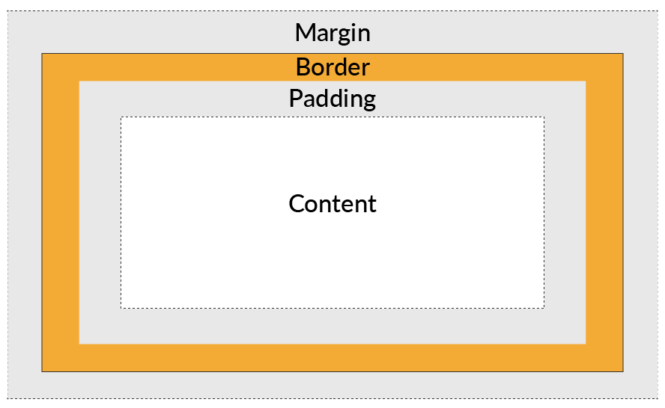
CSS Box Model

Slide 45
CSS Box Model
The box model consists of four things:
Content
Padding
Border
Margin

Slide 46
CSS Margins
CSS Box Model

Slide 47
CSS Margins
Introduction to Margins
Margins are essentially the spaces outside the element. They are the spaces that are away from the element. An element can have margins on all the four sides - top, right, bottom and left.
body
<div>
Shaded area is the margin

Slide 48
CSS Margins
Syntax
Margins can be set simply by calling the margin property and giving it a value.
70px
div { margin: 70px; }
70px
70px
70px

Slide 49
CSS Margins
Margin for Every Side
Margins can be set for all the individual sides as shown below.
.block1
.block1
.block2
.block1
.block2
.block1
.block2
.block2
.block2 { margin-top: 70px; }
.block2 { margin-left: 70px; }
.block1 { margin-right: 70px; }
.block1 { margin-bottom: 70px; }

Slide 50
CSS Margins
Margin Shorthand
TOP
Margins can be given shorthand for every side.
LEFT
RIGHT
BOTTOM
margin: 70px; /* SHORTHAND - This will give 70px as margin to all the sides. */
margin: 70px 50px; /* This will give 70px as margin to top & bottom; 50px to right & left. */
margin: 70px 50px 40px; /* This will give margin 70px to top; 50px to right & left; 40px to bottom. */
margin: 70px 50px 40px 60px; /* Margins are 70px to top; 50px to right; 40px to bottom; 60px to left. */

Slide 51
Aligning Element Horizontally in Center
Margin Auto
To horizontally centre an element within a container, you can use margin: 0 auto.
The element should be given a specific width, and then, the margin should be set to 0 auto.
The element will take up whatever width is given to it, and the remaining width will be equally split owing to the value auto of margin property.
div { width: 300px; margin: 0 auto; }

Slide 52
Aligning Element Vertically in Center
<head> <title>Vertical Align</title> <style> .container { width: 100px; height: 100px; border: 1px solid blue; background-color: black; margin: auto; margin-top: 20%; margin-bottom: 20%; } </style> </head> <body> <div class="container"></div> </body>
We can vertically align a div using margin property.

Slide 53
Poll 9 (15 Sec)
According to the code given below, which of the following are the values of a margin ?
margin-top: 20px; margin-right: 30px; margin-left: 40px; margin-bottom: 10px
margin-left: 10px; margin-top: 20px; margin-right: 30px; margin-bottom: 40px
margin-right: 20px; margin-left: 30px; margin-top: 40px; margin-bottom: 10px
margin-top: 10px; margin-right: 20px; margin-left: 30px; margin-bottom: 40px
div { margin: 10px 20px 30px 40px; }
Practice in teams of 4 students
Industry expert mentoring to learn better
Get personalised feedback for improvements
11

Slide 54
Poll 9 (Answer)
According to the code given below, which of the following are the values of a margin ?
margin-top: 20px; margin-right: 30px; margin-left: 40px; margin-bottom: 10px
margin-left: 10px; margin-top: 20px; margin-right: 30px; margin-bottom: 40px
margin-right: 20px; margin-left: 30px; margin-top: 40px; margin-bottom: 10px
margin-top: 10px; margin-right: 20px; margin-left: 30px; margin-bottom: 40px
div { margin: 10px 20px 30px 40px; }
Practice in teams of 4 students
Industry expert mentoring to learn better
Get personalised feedback for improvements
11

Slide 55
CSS Borders
CSS Box Model
Yay!! I have a border!

Slide 56
CSS Borders
Introduction to Borders
A border is a covering around an element. An element has borders on all the four sides: top, right, bottom and left.
<div>
Border

Slide 57
CSS Borders
Border-Style and Border-Width
border-width
The border-width property specifies the width that needs to be given to the borders. It can be in px or thick/thin/medium. The default value of border-width property is medium.
div { border-width: thick; }
border-style
The border-style property denotes the shape and the style of a border. It can be dotted, dashed, solid, double, etc.
The default value of border-style property is none.
div { border-style: dotted; }
CSS Borders

Slide 58
CSS Borders
Border-Color and Border (Shorthand)
border-color
The border-color property assigns a color to the border.
div { border-color: blue; }
border
The border shorthand property needs the following syntax: border: border-width border-style border-color. It is mandatory to give a border-style property for the border to be visible.
div { border: 1px solid red; }

Slide 59
CSS Borders
Individual Borders
In CSS, you can assign different values to the individual sides (top, right, bottom and left) of the borders.
You can either specify the value individually using properties, such as the border-top-style or border-bottom-width property, or you can use the shorthand property. Here, you will learn about the shorthand property.
border-color: blue; /*This will give blue color to all borders */
border-color: blue red; /*top & bottom – blue; right & left - red*/
border-color: blue red green; /*top – blue; right & left – red; bottom – green */
border-color: blue red green yellow; /*top – blue; right – red; bottom – green; left- yellow */

Slide 60


CSS Borders
Border-Style and Border-Width
border-top-style
The border-top-style property can be used to set the style top border. The values of border-top-style property can be none, dotted, dashed, solid, groove, inset. The default value of this property is none.
div { border-top-style: dotted; }
border-bottom-width
The border-bottom-width is the shorthand property of set the border bottom width, border bottom style and border bottom color. The default value of border-bottom-width shorthand property is medium none color.
div { border-bottom-width: 4px solid black; }
CSS Borders

Slide 61
CSS Borders
Rounded Border
border-radius
The border-radius property makes the border take circular shape and hence you need to define the radius for the circle. You can also assign a different radius to an individual border.
div { border: 1px solid blue; border-radius: 10px; }

Slide 62
CSS Borders
Individual Sides
TOP
LEFT
RIGHT
BOTTOM
For borders, margins and paddings, you can set different properties to individual sides using a shorthand property.
To remember the shorthand property, think of a box and start clockwise from the top. The next sides would be in the following order: right, bottom and left.
If there are four values, then the order would be top right bottom left; if there are three, then the order would be top right & left bottom; if there are two, then the order would be top & bottom right & left; and if there is only one, then the order would be all top & right & bottom & left; in short, all the sides.

Slide 63
Poll 10 (15 Sec)
In the code given below, of which of the following is the shorthand property for border?
Note: More than one option can be correct
border-width border-style border-color
border-radius border-style
border-width border-style border-color border-radius
border-style border-color
div { border: 1px solid blue; }
Practice in teams of 4 students
Industry expert mentoring to learn better
Get personalised feedback for improvements
11

Slide 64
Poll 10 (Answer)
In the code given below, of which of the following is the shorthand property for border?
Note: More than one option can be correct
border-width border-style border-color
border-radius border-style
border-width border-style border-color border-radius
border-style border-color
div { border: 1px solid blue; }
Practice in teams of 4 students
Industry expert mentoring to learn better
Get personalised feedback for improvements
11

Slide 65
Poll 11 (15 Sec)
Which of the following properties helps you achieve rounded border?
border-width
border-style
border-color
border-radius
Practice in teams of 4 students
Industry expert mentoring to learn better
Get personalised feedback for improvements
11

Slide 66
Poll 11 (Answer)
Which of the following properties helps you achieve rounded border?
border-width
border-style
border-color
border-radius
Practice in teams of 4 students
Industry expert mentoring to learn better
Get personalised feedback for improvements
11

Slide 67
Doubt Clearance (5 min)

Slide 68
CSS Paddings
CSS Box Model

Slide 69

CSS Paddings
Introduction to Paddings
Paddings are essentially the spaces inside an element, i.e., they are the spaces between the content inside the element and the element’s borders. An element has padding on all four sides: top, right, bottom and left.
<div>
This is the text inside the element.

Slide 70
CSS Paddings
Syntax
Paddings for all the sides together can be set by simply calling the padding property and assigning it a value.
<div> <p>This is a paragraph.</p> </div> div { border: 1px solid red; padding: 20px; }
20px
20px
This is a paragraph.
20px
20px

Slide 71
CSS Paddings
Paddings for Every Side
Paddings can be set for all the individual sides as shown below.
.outside-box
.outside-box
.outside-box
.outside-box
.inside-box
.inside-box
.inside-box
.inside-box
.outside-box { padding-top: 20px; }
.outside-box { padding-left: 20px; }
.outside-box { padding-right: 20px; }
.outside-box { padding-bottom: 20px; }

Slide 72
CSS Paddings
Paddings Shorthand
TOP
Similar to borders and margins, paddings can also be given a shorthand for every side.
LEFT
RIGHT
BOTTOM
padding: 70px; /* SHORTHAND - This will give 70px as padding to all the sides. */
padding: 70px 50px; /* This will give 70px as padding to top & bottom; 50px to right & left. */
padding: 70px 50px 40px; /* This will give padding 70px to top; 50px to right & left; 40px to bottom. */
padding: 70px 50px 40px 60px; /* Paddings are 70px – top; 50px – right; 40px – bottom; 60px – left. */

Slide 73
CSS Paddings
Box-Sizing
Question: What will be the total width of the div that has the class inside-box?
<div class=“outside-box”> <div class=“inside-box”> This is a paragraph. </div> </div> .inside-box { padding: 20px; width: 300px; }
This is a paragraph.
20px
300px
20px
20px + 300px + 20px = 340px

Slide 74
CSS Paddings
Box Sizing: Content-Box
<div class=“outside-box”> <div class=“inside-box”> This is a paragraph. </div> </div> .inside-box { padding: 20px; width: 300px; }
This is a paragraph.
20px
300px
20px
20px + 300px + 20px = 340px
As you noticed, padding increases the width of the div. There might be instances where you do not need the padding effect. For such instances, you can use the box-sizing property.
This property of box-sizing that affects the width is the content-box property (i.e. width and height properties of the div include the content. However, the other box properties such as padding, border, or margin are not considered. content-box property is the default value.

Slide 75
CSS Paddings
Box Sizing: Border-Box
<div class=“outside-box”> <div class=“inside-box”> This is a paragraph. </div> </div> .inside-box { padding: 20px; width: 300px; box-sizing: border-box; }
This is a paragraph.
20px
20px
300px
While using the value border-box for box-sizing property, the element’s content width is adjusted so that the total width remains 300px.

Slide 76
CSS Box Model
CSS Box Model

Slide 77
CSS Box Model
The CSS box model is a box that surrounds every HTML element. It comprises the following: content + padding + border + margin.
Therefore, the total width of element = Actual width + Left padding + Right padding + Left border + Right border + Left margin + Right margin.
The total height of element = Actual height + Top padding + Bottom padding + Top border + Bottom border + Top margin + Bottom margin.

Slide 78
CSS Outline

Slide 79
CSS Outline
Introduction to Outline
Outlines are the lines around the element, that is, Outside the element.
Outline

Slide 80
CSS Outline
Introduction to Outline
Outlines are the lines around the element, that is, Outside the element.
Outline
Outline | Border
Outlines will never take up space because they are drawn outside the elements content. | Whereas borders take up some space.
Each edge of the outline cannot be set to different widths, colors and style. | Each edge of the border can be set to different width, color and style.
Outline does not allow us to change the size of the element. | Border allows us to change the size of the element.

Slide 81
CSS Outline
Outline Properties
The outline-style property gives style to the outline (e.g., dotted, dashed and solid).
outline-style: dotted;
The outline-width property gives width to the outline (e.g., px, thin, medium and thick).
outline-width: 20px;
The outline-color property gives color to the outline (e.g., blue, orange, red and green). If we want the outline to be visible regardless of the background, you can invert it which will , perform a color inversion of the background.
outline-color: blue;
Outline Shorthand
For the outline shorthand, you need to specify the outline-width outline-style and outline-color.
outline: 20px solid blue;

Slide 82
CSS Outline
Outline Offset
The outline-offset property adds space between the outline and the border/edge of the element. The space between an element and a border is transparent.
outline
div { background: green; color: white; margin: 30px; border: 1px solid black; outline: 1px solid red; outline-offset: 15px; }
outline-offset
margin
This is a div.

Slide 83
Poll 12 (15 Sec)
Which of the following is true about the padding property in CSS?
It is used to create a border around an HTML element.
It is used to create space around an HTML element outside the confined borders.
It is used to create space around an HTML element inside the confined borders.
Both 1 and 3
Practice in teams of 4 students
Industry expert mentoring to learn better
Get personalised feedback for improvements
11

Slide 84
Poll 12 (Answer)
Which of the following is true about the padding property in CSS?
It is used to create a border around an HTML element.
It is used to create space around an HTML element outside the confined borders.
It is used to create space around an HTML element inside the confined borders.
Both 1 and 3
Practice in teams of 4 students
Industry expert mentoring to learn better
Get personalised feedback for improvements
11

Slide 85

Project Work
(Let’s add some more CSS to our project.)
You can refer to the solution here.

Slide 86
Doubt Clearance (5 min)

Slide 87
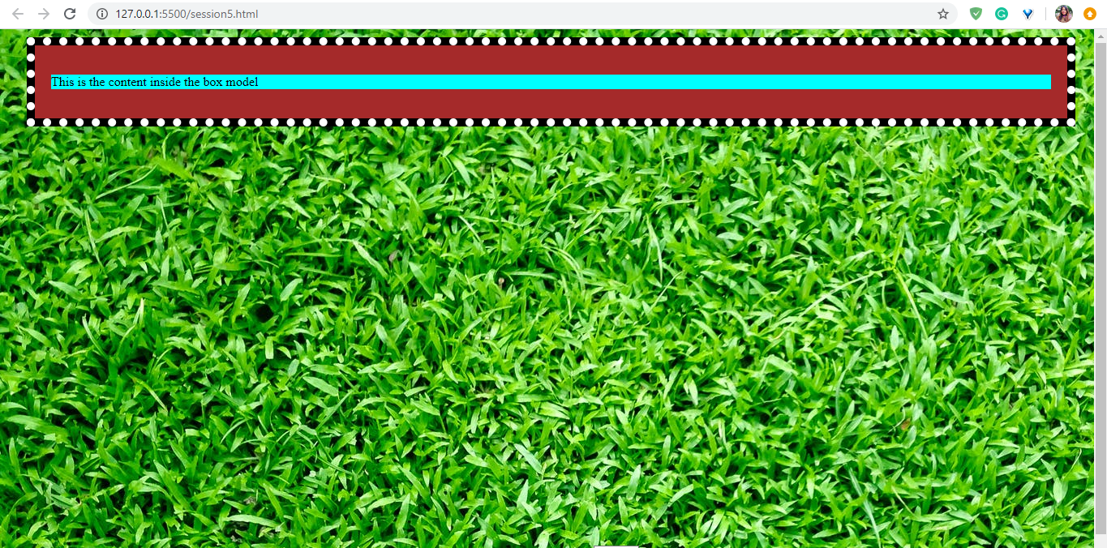
Hands-On Exercise (3 min)
Write a program for the given stub code such that the output is as shown in the adjoining screenshot.
Here,
You can set the background image of the body as follows: https://images.pexels.com/photos/413195/pexels-photo-413195.jpeg?auto=compress&cs=tinysrgb&dpr=2&h=650&w=940
The body should cover the entire page.
The background color for the content div is aqua.
The background color for the padding div is brown, and the padding is 20px.
The background color for the border div is black. The border is 10px and is dotted and represented in white.
The background color for the margin div is yellow. The top margin is 10px, the right one is 15px, the bottom one is 20px and the left one is 25px.
The stub code is provided here.
The solution is provided here.

Slide 88
Key Takeaways
The six ways of defining colors are as follows: color-name; HEX; RGB; HSL; RGBA; and HSLA, where A stands for opacity.
You can set a background color or a background image. Background images can be made to fit an entire container or can be set to be repeated. Additionally, they can be set to scroll with the container or stay fixed.
HTML elements have the following four primary properties: content, padding (between the edge of the element and the content), border (a line along the edge of the element) and margin (the space outside the element’s edge/border).
Combination of these aforementioned properties is called the CSS box model.
The CSS outline is the line outside the margin of the element.

Slide 89
The following tasks are to be completed after today’s session:
MCQs
Coding Questions
Project - Checkpoint 5

Slide 90
In the next class, we will discuss...
How to style text elements such as p and span as well as link tags using CSS
The different font styles and the ways to change them using CSS
How to add icons to a website and from where to source them
How to position elements using CSS
How to show/hide elements, scroll or overflow them, stack them and lighten them using CSS

Slide 91
#RahoAmbitious
Thank you!

